Slide 1
Static
Program Analysis
Herman Ciechanowiec
Cracow
2022

Slide 2
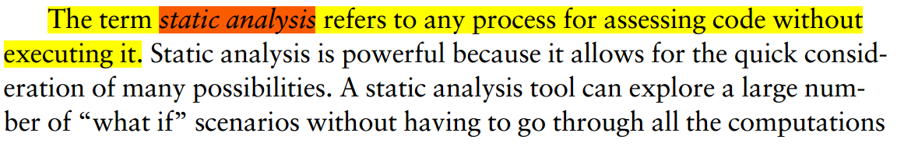
Static Program Analysis
DEFINITION
- Chess B., West J., Secure Programming with Static Analysis, Boston 2007, p.3

Slide 3
Static Program Analysis
FLOW
CODE BASE
ANALYZER
CODE BASE
remarks:
1) infinite loop
2) calling a method on a null
analysing and drafting remarks…

Slide 4
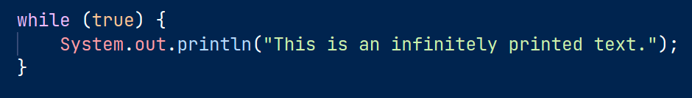
Static Program Analysis
EXAMPLE
Static Program Analysis
remarks:
infinite loop in the code!

Slide 5



Static Program Analysis
SAMPLE TOOLS
1.
2.
3.

Slide 6
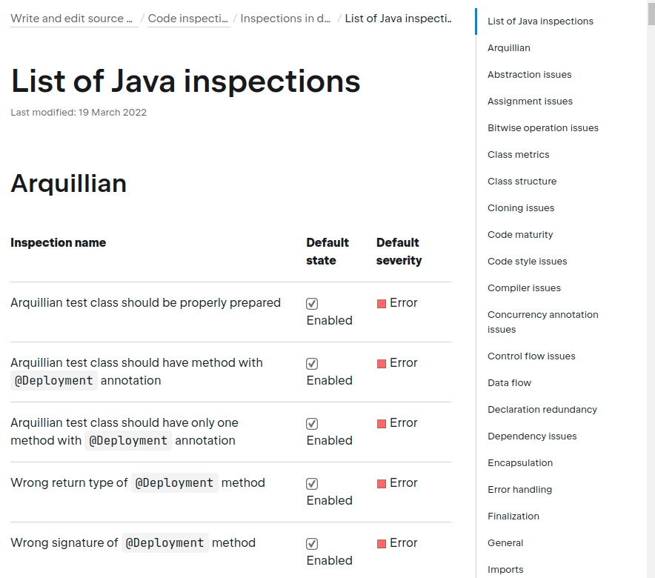
IntelliJ IDEA
LIST OF CHECKS
https://www.jetbrains.com/help/idea/list-of-java-inspections.html
> 800 inspections

Slide 7
IntelliJ IDEA
USAGE
Tools Bar ➔ Code ➔ Inspect Code ➔
➔ Inspection Scope: file “IntelliJ.java” ➔
➔ OK

Slide 8
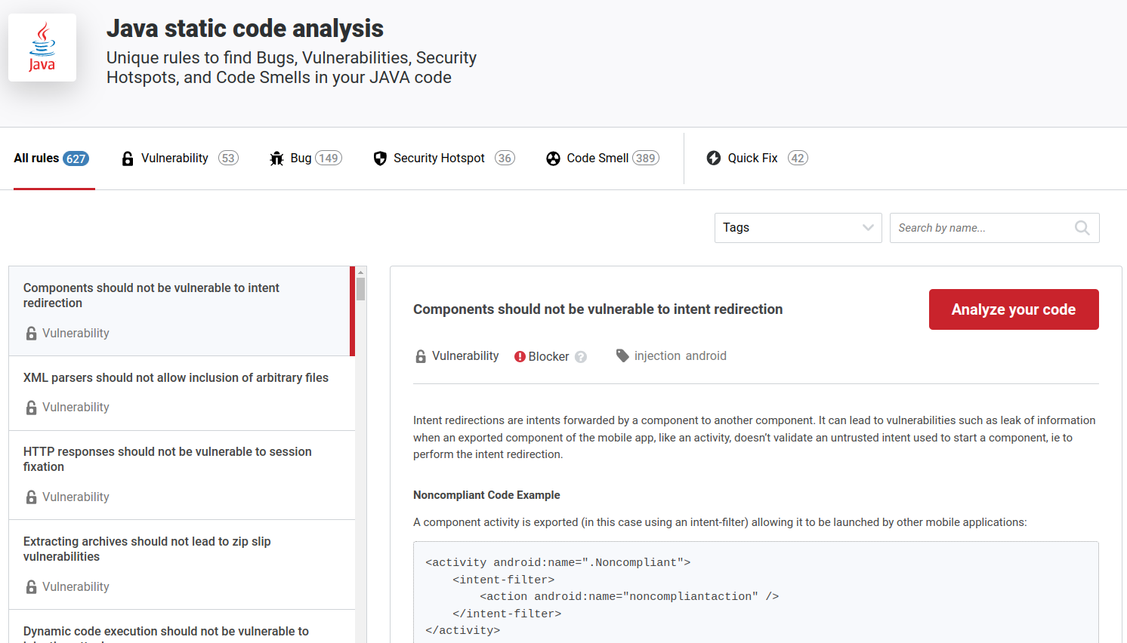
SonarLint
LIST OF CHECKS
https://rules.sonarsource.com/java
> 600 inspections

Slide 9
SonarLint
USAGE
1. Install SonarLint as a plugin for IntelliJ IDEA
2. Bottom Tools Bar ➔ SolarLint ➔
➔ Analyze with SolarLing (green arrow-button)

Slide 10
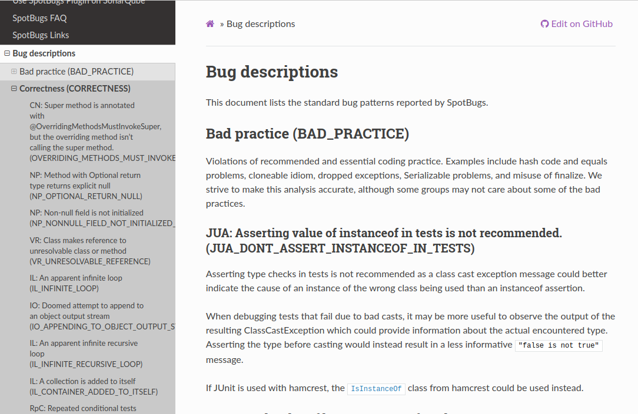
SpotBugs
LIST OF CHECKS
https://spotbugs.readthedocs.io/en/stable/bugDescriptions.html
> 450 inspections

Slide 11
SpotBugs
USAGE
1. Install SonarLint as a plugin for IntelliJ IDEA
2. Bottom Tools Bar ➔ SpotBugs ➔
➔ Focus cursor on the current file in the Editor ➔
➔ Analyze Current File (red bug-button with green arrow)

